Slide 1

Milestone 2: Testing
Software Engineering
for AI Enabled Systems
Students: Basile Andrea, Iacovazzi Antonio Raffaele, Lorusso Roberto

Slide 2
Testing Data
In a ML model data are the most critical aspect, as the motto says "trash in - trash out" so we need to carefully check if data are coherent with a set of predefined quality check and avoid that strange values could spoil the training phase and the overall model's quality.
Especially in dataset that grow over time, for example collecting users data, this step is crucial since there are chance that users could send non reliable data.

Slide 3

Great Expectations
A tool that can help us to do this kind of tests is Great Expectations.
It offers a set of functionality that helps developers to build up reliable tests on datasets.
Great Expectations is oriented to tabular data and not images like in our project, but this has not been a problem, we have extracted a set of information from our dataset and saved them into a .csv file generated before applying the GE test suite.

Slide 4
Great Expectations: Feature Extraction
The information extracted are the followings:
File Name
File Type
Label
Colors (Y/N)
Height
Width
Variance of the Laplacian Filter

Slide 5

Great Expectations: Setting Up
The GE suite has been created importing the GE library and running the following commands:
that, in order:
create the whole infrastructure
link GE to the file that we want to check
create the test suite
create the checkpoint that is the mechanism that allows to run the tests

Slide 6
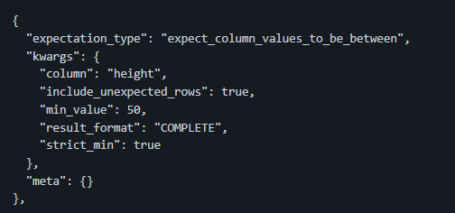
Great Expectations: A Sample Of Test
The test suite is a json file presents in great_expectations\expectations\img_features_suite.json were it's possible to express the kind of test, the checked column and the acceptable values for that column, for example:
This test checks that the column heigh has value greater than 50, this in order to avoid to train our model on really small images that have too less details and became noisy when scaled up.

Slide 7
Great Expectations: The Test Suite
The whole test suite include the followings tests:
Check on the label name: we want to avoid label that are not coherent with our purposes
Check on the color type: we want to allow or deny the possibility to add greyscale images
Check on the variance of the Laplacian filter greater than 0: if the Laplacian variance is 0 the image is monochromatic and then non informative, we want to block this kind of data
Checks on the heigh greater than 50: in order to avoid pictures that are too small
Checks on the width greater than 50: in order to avoid pictures that are too small
All the execution are stored into:
great_expectations\results\validations
and is possible to see the results through a GUI using the html page stored in:
great_expectations\results\data_docs\local_site\index.html

Slide 8

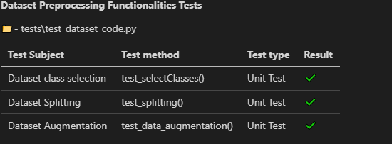
Testing Code with Pytest
In order to verify that the code perform its task in a correct way we need a mechanism that run the code in a close context and make assertion about the correctness of the results.
These mechanisms are the Unit Test and the Integration Test, the first type check the correctness of a function or a method, the second check the correctness of a whole sequence of modules.
In our project Pytest has been used in order to implement this kind of test and we have checked the correctness of the following modules:

